Slide 1
HOUSE PRICE PREDICTION PROJECT
Submitted by
Yashna Shah

Slide 2
Problem Statement
A US-based housing company named Surprise Housing has decided to enter the Australian market. The company uses data analytics to purchase houses at a price below their actual values and flip them at a higher price. For the same purpose, the company has collected a data set from the sale of houses in Australia.
Here, we need to build a model using Machine Learning in order to predict the actual value of the prospective properties and decide whether to invest in them or not. For this company wants to know:
1) Which variables are important to predict the price of houses?
2) How do these variables describe the price of the house?

Slide 3
Data sources and formats
Train file will be used for training the model, where the model will learn from this file. The training data contains all the independent variables and the target variable. The size of the train data is 1168 records
Test file contains all the independent variables, but not the target variable. Here we will be applying the model to predict the target variable. The size of the test data is 292 records.

Slide 4
Problem Solving Approaches
Data reading and understanding
Data cleaning
Data analysis
Handling outliers
Handling skewness
Encoding data
Scaling
Train test split
Machine learning algorithms

Slide 5
Data preparation and cleaning
Loading the dataset
Checked the number of rows and columns in the dataset using df.shape().
Checked the null values in the dataset and filled them using mean, median mode.
Dropped the unrequired columns from the dataset.
Checked the unique values.
Converted all the data to numeric data type using Label Encoding technique

Slide 6
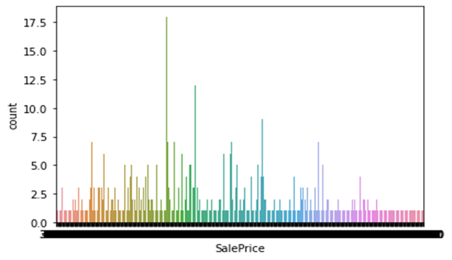
Countplot of Target Variable (SalePrice) : we can observe that the maximum number of SalePrice lies between 140000 and 230000.

Slide 7
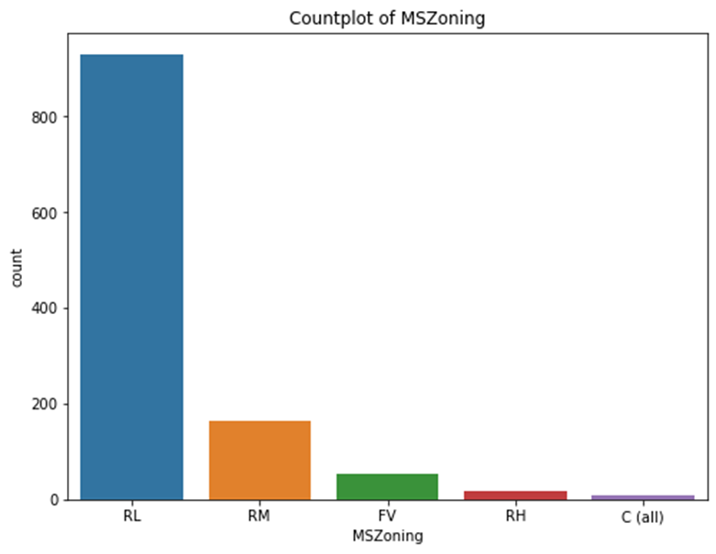
Countplot of column MSZoning: here, we observe that the maximum(928)number of MSZoning are RL.
RL 928
RM 163
FV 52
RH 16
C (all) 9
Name: MSZoning, dtype: int64

Slide 8
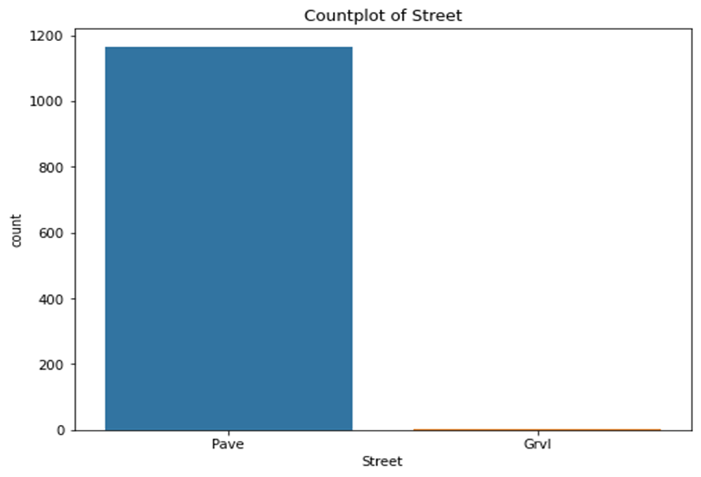
Countplot of Column Street: the maximum number of Street are Pave i.e 1164 where as only 4 are Grvl.

Slide 9
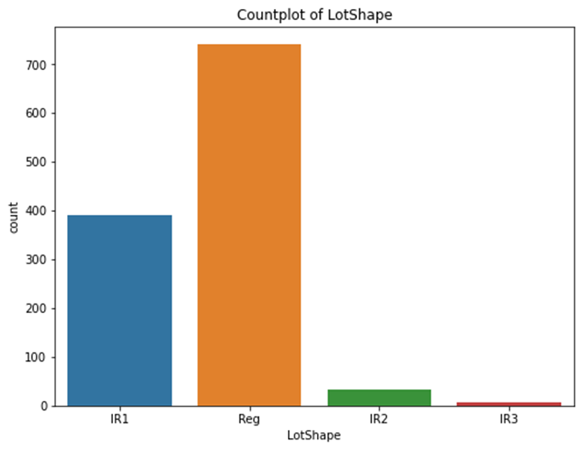
Countplot of column LotShape: we can say that the maximum number of LotShape are Reg i.e 740

Slide 10
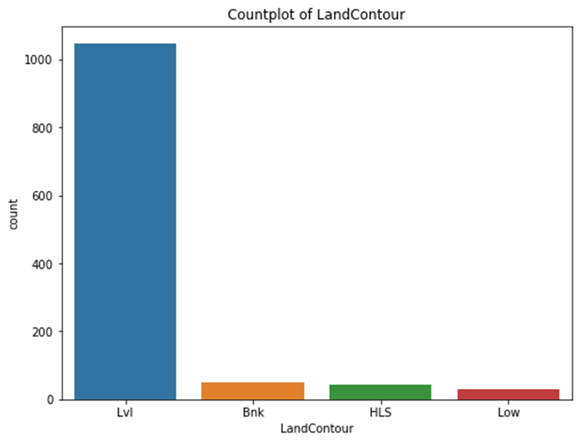
Checking the countplot of column LandContour we can observe that the maximum number of Land Contour are Lvl i.e 1046.

Slide 11
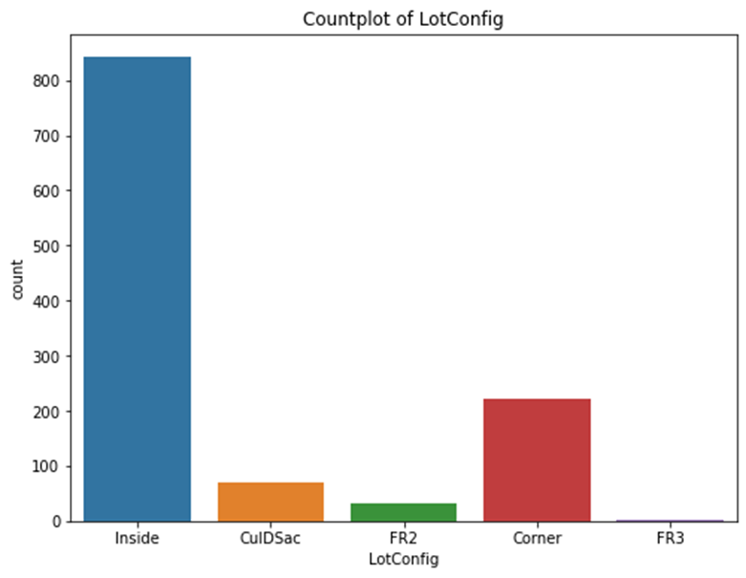
Countplot of column LotConfig : we can observe that the maximum number of LotConfig are Inside i.e 842

Slide 12
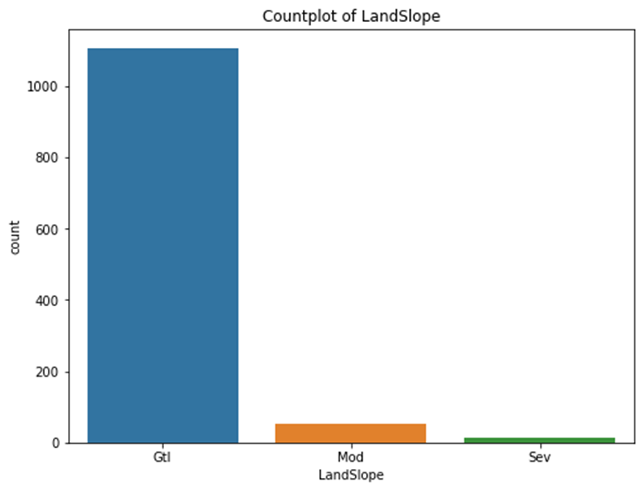
Countplot of column LandSlope: we can say that the maximum number of LandSlope are Gtl 1105

Slide 13
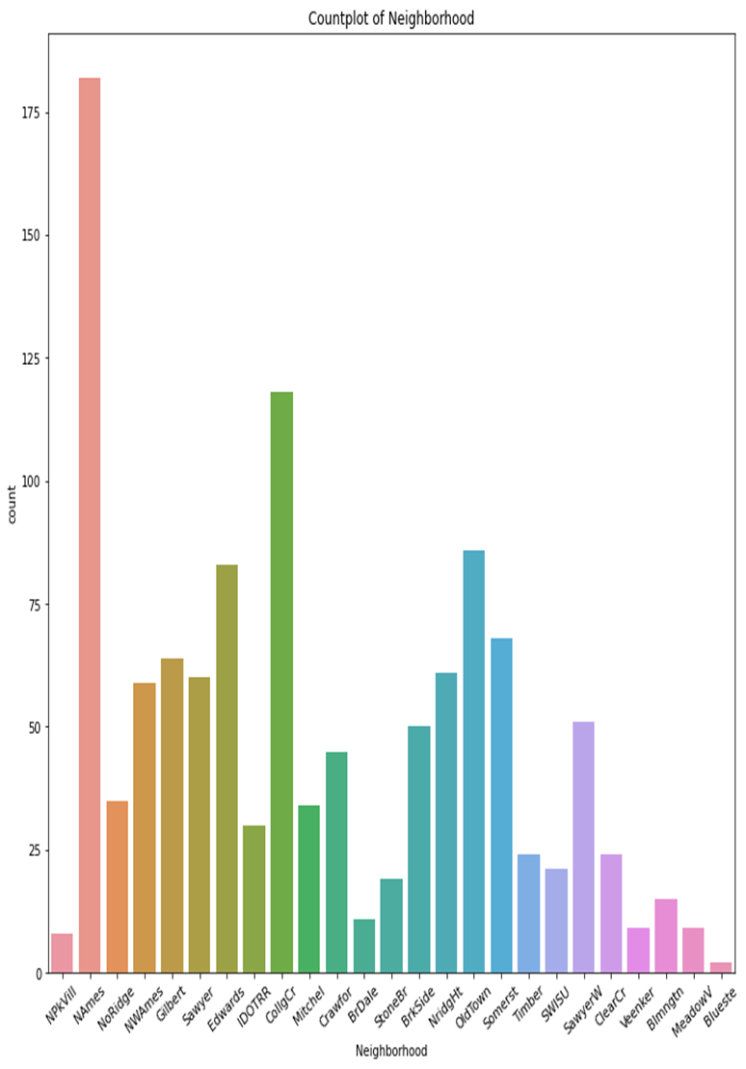
Countplot of column Neighbourhood: we can say that the maximum number of Neighborhood are Names i.e 182.

Slide 14
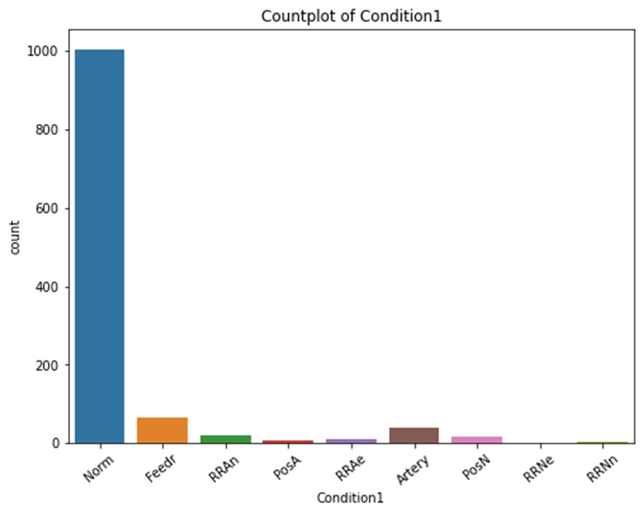
Countplot of column Condition1: we can say that the maximum number of Condition1 is Norm i.e 1005.

Slide 15
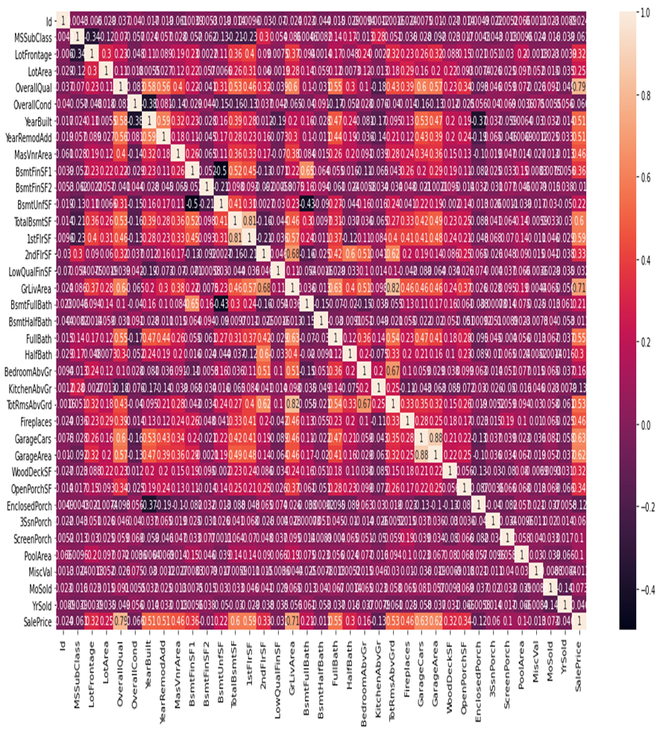
Checking the correlation among the variables and plotting a correlation matrix for graphical representation.
from the above plot we observe that SalesPrice is highly positively correlated with the columns OverallQual, YearBuilt, YearRemodAdd, TotalBsmtSF, 1stFlrSF, GrLivArea, FullBath, TotRmsAbvGrd, GarageCars, GarageArea. whereas SalePrice is negatively correlated with OverallCond, KitchenAbvGr, Encloseporch, YrSold. There is multicollinearity in between columns so we will be using Principal Component Analysis(PCA). No correlation has been observed between the column Id and other columns so we will be dropping this column.

Slide 16
Handling Skewness
In this dataset some attributes are skewed and skewness is affecting our machine learning model. So, it is necessary to remove skewness. For solving this issue we use log method. This method follows a normal or near normal distribution of the data. we can see that skewed data of some variables in form of graphical representation:
After that we encoding categorical data into numerical data using one hot encoding method for further process.

Slide 17
Scaling Data
After encoding data, we need to scale our data. For this we use standard scaler method. This method normalizes our data and essential for machine learning algorithms that calculate distance between data.
This method is necessary, where large and small values present in our data. This method transform our data with mean = 0 and standard deviation = 1.

Slide 18
Train test split
we split our training dataset into two segments: training and testing. We take 75% data for training and 25% data for testing. For splitting data we use train test split method. Below is the code for splitting the data:
75% of the observation as training set--> x_train
The associated target for each observation in x_train --> y_train
25% of the observation as test set--> x_test
The target associated with the test set--> y_test.

Slide 19
Identification of possible problem-solving approaches (methods)
We had null values in our dataset, which we imputed using mean, median and mode methods.
Dropped unrequired columns.
Converted all the categorical data into numeric data using Label Encoder.
Identified skewness and outliers in the dataset and removed the outliers with the help of z-score method.
Splitting the dataset and scaling the data with Standard Scaler method
Used PCA for multicollinearity.
Performed Feature Importance using Extra Trees Regressor

Slide 20
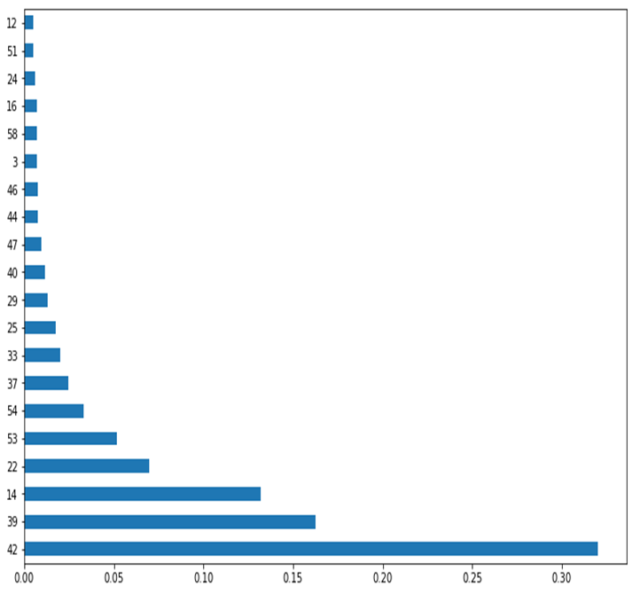
Feature Importance

Slide 21
Testing of identified approaches
1. Linear Regression Model
2. RIDGE Regularization Regression Model
3. LASSO Regularization Regression Model
4. SGB Regressor
5. Random Forest Regressor.
These algorithms have been used for both training and testing the model.

Slide 22
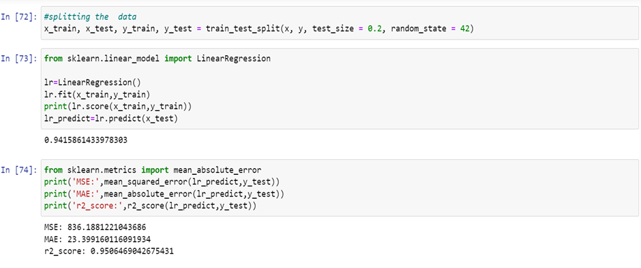
Building machine learning model
We use many algorithms to find best model, but here we describe only best model.

Slide 23
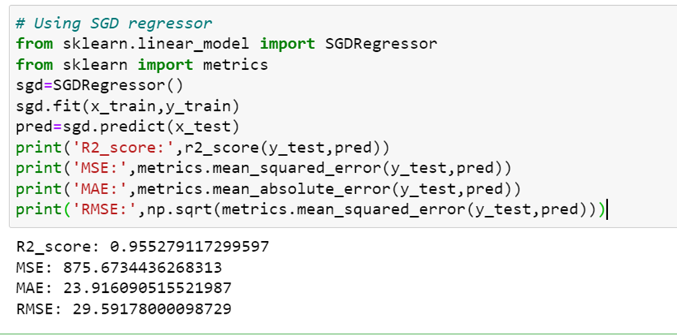
Contd…

Slide 24
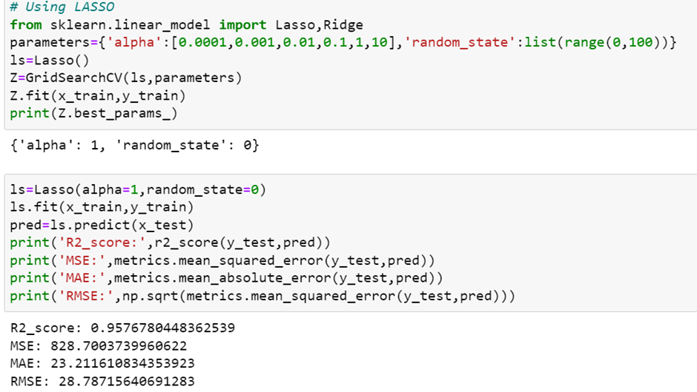
Contd..

Slide 25
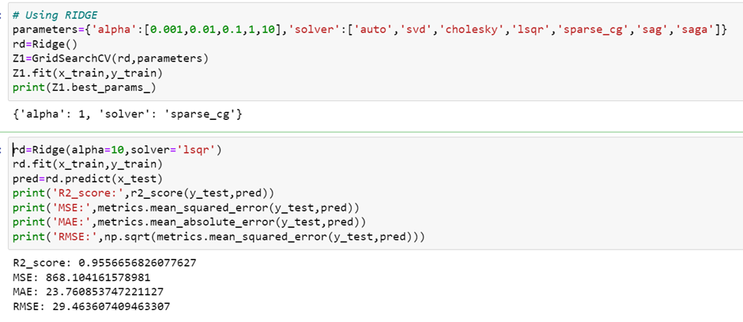
Contd…

Slide 26
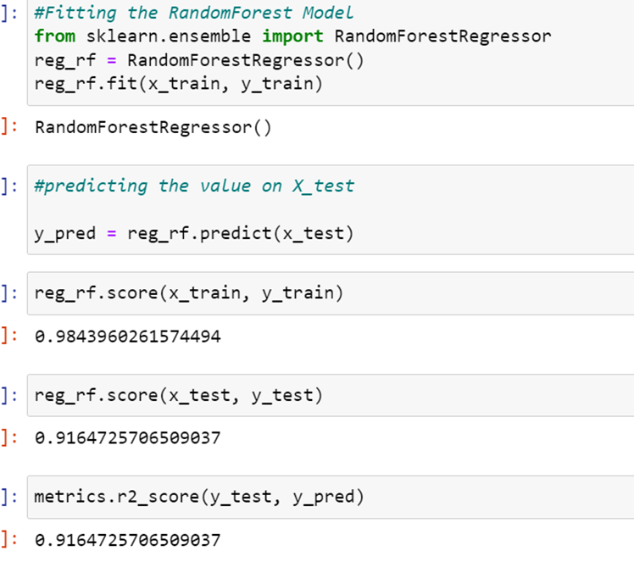
Contd…

Slide 27
Key Metrics Used
Will go with Random Forest Regressor
Reasons
1. Random Forest reduces overfitting in decision tree and helps to improve accuracy. 2. It is flexible for both classification and regression tasks.
3. It also works well with both categorical and continuous values.
4. It is a rule based approach.
5. It automates missing values present in the data
The key metrics used here were R2_Score, MSE, MAE, RMSE and Cross Validation Score. We also tried to find out the best parameters by using Hyper Parameter Tuning and Random Grid Search to increase the accuracy score.

Slide 28
CONCLUSION
The purpose of this article was twofold: to understand the pattern of Australian real estate market and make predictive model, which is able to effectively predict the price of houses in Australia.
We use many algorithms to find best model and best result were observed of the catboost regressor with 84% r2 score accuracy.
There are many variables important to predict the price of houses. Like quality of houses, exterior quality, basement area, kitchen quality, total rooms above grade and many more.
In order to increase profit of surprise housing company, the company should start using of machine learning model.
By using machine learning model company can decide whether to invest in properties or not.

